Slide 1

Building a Web App with ASP.NET Core, MVC 6, EF Core and Angular
What Is ASP.NET Core?
Shawn Wildermuth
@shawnwildermuth | wilderminds.com

Slide 2

Course Overview
What is this course?
Build a web app using ASP.NET Core
Learn by doing
Feel free to follow along
You’ll see it all

Slide 3
Course Overview
What this course will teach you:
ASP.NET Core and MVC 6
HTML5, JavaScript, CSS
Using Bootstrap
Data with Entity Framework Core
Client-side with AngularJS

Slide 4
Course Overview
What is this course built with?
Visual Studio 2017
ASP.NET Core 1.1
Entity Framework Core 1.1
Bootstrap 3.3
Angular 1.5

Slide 5
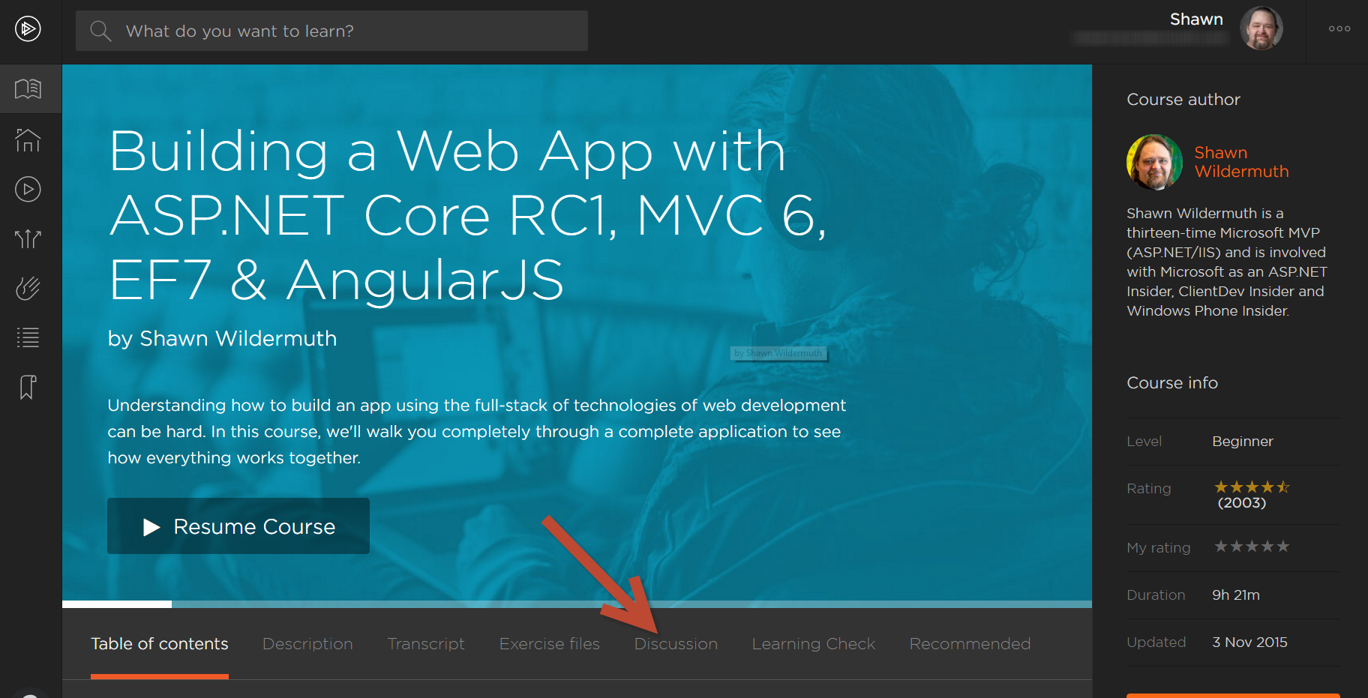
Questions During the Course?

Slide 6
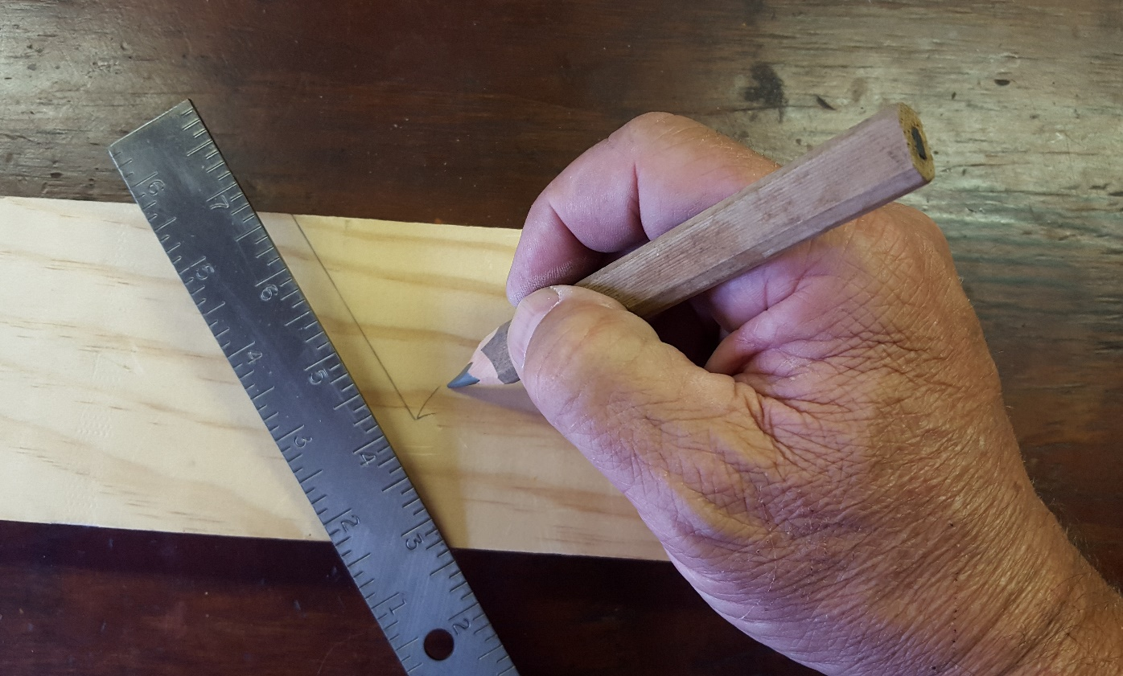
This Module
ASP.NET Core Basics

Slide 7
Why Reinvent ASP.NET?
What was the motivation?
The Web Stack is *old*!
Weighed down by old, unused code
Primarily in System.Web
Depending on machine level upgrades to .NET was problematic
Performance was as fast as it could be on existing platform

Slide 8
ASP.NET Core is a complete rethinking of the platform.

Slide 9
What Is ASP.NET Core?
Complete re-write of the platform
Cross-platform and open source
Single platform (MVC and WebAPI are combined, and WebForms is gone)
Everything is a dependency – your app will be as lean as you like
Low memory footprint
Multiple deployment support
Cloud, IIS, Self-Hosting, etc.

Slide 10
Overview
Unix/Linux/OSX
Windows
ASP.NET Core
(e.g. MVC6, EF Core, etc.)
Mono
.NET Core
(CoreCLR)
.NET 4.6
(.NET CLR)
Self Hosted (dotnet cli)
Self Hosted (dotnet cli)
IIS Native Loader

Slide 11
Three Frameworks?
Frameworks are about cross-platform
.NET 4.6
The .NET you’ve always known
.NET Core
The cross-platform .NET Framework (in progress!)
Mono
The existing open source cross-platform .NET Framework
Notes:
After Beta 6, .NET Core shouldn’t be in progress #fix

Slide 12
CoreCLR is a subset of the .NET Framework. You‘ll need to work around missing functionality outside of ASP.NET Core.

Slide 13
Completely Composed
Everything above the .NET layer is a NuGet Package
The frameworks are the bootstrap and CLR, not much more
MVC, StaticFiles, Logging, Configuration, Identity, etc. are all just packages
Everything is optional

Slide 14
Embraces Open Web Development
Uses existing web development tooling
NPM for tooling support
Bower for client-side library support
Grunt and Gulp for build automation
NuGet for .NET Packages
None of it is required

Slide 15
Demo
Installing ASP.NET Core

Slide 16
Demo
Hello World

Slide 17
Demo
Creating a Project for VS Code

Slide 18
Demo
The Empty Project with Visual Studio

Slide 19
Demo
Where We’re Headed

Slide 20
What We’ve Learned
What is ASP.NET Core?
It’s a whole new .NET world out there!
You have full support to go command-line or IDE
Open Source top-to-bottom

